Slide 1
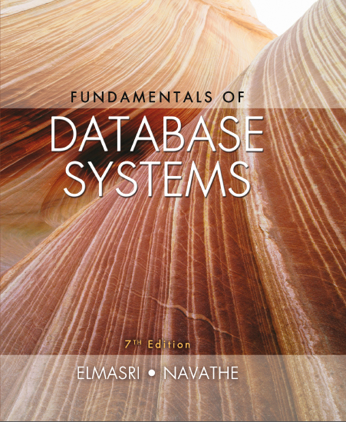
Fundamentals of Database Systems
Seventh Edition
Chapter 21
Concurrency Control Techniques
Copyright © 2016, 2011, 2007 Pearson Education, Inc. All Rights Reserved
Notes:
If this PowerPoint presentation contains mathematical equations, you may need to check that your computer has the following installed:
1) MathType Plugin
2) Math Player (free versions available)
3) NVDA Reader (free versions available)

Slide 2
Introduction
Concurrency control protocols
Set of rules to guarantee serializability
Two-phase locking protocols
Lock data items to prevent concurrent access
Timestamp
Unique identifier for each transaction
Multiversion currency control protocols
Use multiple versions of a data item
Validation or certification of a transaction

Slide 3
21.1 Two-Phase Locking Techniques for Concurrency Control (1 of 5)
Lock
Variable associated with a data item describing status for operations that can be applied
One lock for each item in the database
Binary locks
Two states (values)
Locked (1)
Item cannot be accessed
Unlocked (0)
Item can be accessed when requested

Slide 4
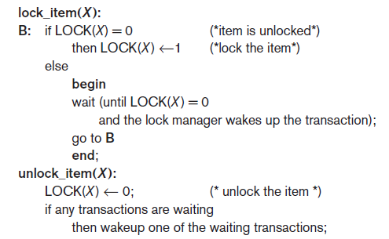
Two-Phase Locking Techniques for Concurrency Control (2 of 5)
Transaction requests access by issuing a lock_item(X) operation
Figure 21.1 Lock and unlock operations for binary locks

Slide 5
Two-Phase Locking Techniques for Concurrency Control (3 of 5)
Lock table specifies items that have locks
Lock manager subsystem
Keeps track of and controls access to locks
Rules enforced by lock manager module
At most one transaction can hold the lock on an item at a given time
Binary locking too restrictive for database items

Slide 6
Two-Phase Locking Techniques for Concurrency Control (4 of 5)
Shared/exclusive or read/write locks
Read operations on the same item are not conflicting
Must have exclusive lock to write
Three locking operations
read_lock(X)
write_lock(X)
unlock(X)

Slide 7
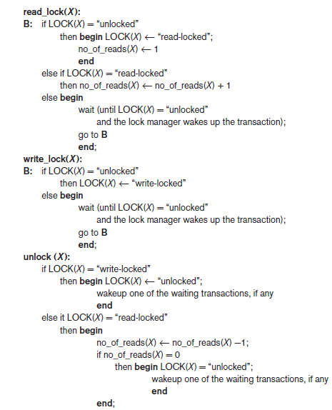
Figure 21.2 Locking and Unlocking Operations for Two-Mode (Read/Write, or Shared/Exclusive) Locks

Slide 8
Two-Phase Locking Techniques for Concurrency Control (5 of 5)
Lock conversion
Transaction that already holds a lock allowed to convert the lock from one state to another
Upgrading
Issue a read_lock operation then a write_lock operation
Downgrading
Issue a read_lock operation after a write_lock operation

Slide 9
Guaranteeing Serializability by Two-Phase Locking (1 of 2)
Two-phase locking protocol
All locking operations precede the first unlock operation in the transaction
Phases
Expanding (growing) phase
New locks can be acquired but none can be released
Lock conversion upgrades must be done during this phase
Shrinking phase
Existing locks can be released but none can be acquired
Downgrades must be done during this phase

Slide 10
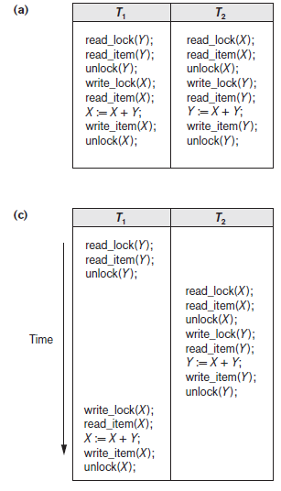
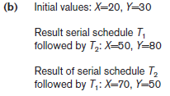
Figure 21.3 Transactions That Do Not Obey Two-Phase Locking (a) Two Transactions T1 and T2 (b) Results of Possible Serial Schedules of T1 and T2

Slide 11
Figure 21.3 Transactions That Do Not Obey Two-Phase Locking (c) A Nonserializable Schedule S That Uses Locks

Slide 12
Guaranteeing Serializability by Two-Phase Locking (2 of 2)
If every transaction in a schedule follows the two-phase locking protocol, schedule guaranteed to be serializable
Two-phase locking may limit the amount of concurrency that can occur in a schedule
Some serializable schedules will be prohibited by two-phase locking protocol

Slide 13
Variations of Two-Phase Locking (1 of 2)
Basic 2 P L
Technique described on previous slides
Conservative (static) 2 P L
Requires a transaction to lock all the items it accesses before the transaction begins
Predeclare read-set and write-set
Deadlock-free protocol
Strict 2 P L
Transaction does not release exclusive locks until after it commits or aborts

Slide 14
Variations of Two-Phase Locking (2 of 2)
Rigorous 2 P L
Transaction does not release any locks until after it commits or aborts
Concurrency control subsystem responsible for generating read_lock and write_lock requests
Locking generally considered to have high overhead

Slide 15
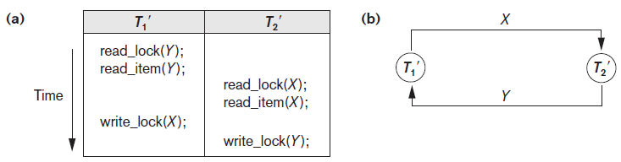
Dealing with Deadlock and Starvation (1 of 4)
Deadlock
Occurs when each transaction T in a set is waiting for some item locked by some other transaction T’
Both transactions stuck in a waiting queue
Figure 21.5 Illustrating the deadlock problem (a) A partial schedule of T₁′ and T₂′ that is in a state of deadlock (b) A wait-for graph for the partial schedule in (a)

Slide 16
Dealing with Deadlock and Starvation (2 of 4)
Deadlock prevention protocols
Every transaction locks all items it needs in advance
Ordering all items in the database
Transaction that needs several items will lock them in that order
Both approaches impractical
Protocols based on a timestamp
Wait-die
Wound-wait

Slide 17
Dealing with Deadlock and Starvation (3 of 4)
No waiting algorithm
If transaction unable to obtain a lock, immediately aborted and restarted later
Cautious waiting algorithm
Deadlock-free
Deadlock detection
System checks to see if a state of deadlock exists
Wait-for graph

Slide 18
Dealing with Deadlock and Starvation (4 of 4)
Victim selection
Deciding which transaction to abort in case of deadlock
Timeouts
If system waits longer than a predefined time, it aborts the transaction
Starvation
Occurs if a transaction cannot proceed for an indefinite period of time while other transactions continue normally
Solution: first-come-first-served queue

Slide 19
21.2 Concurrency Control Based on Timestamp Ordering (1 of 5)
Timestamp
Unique identifier assigned by the D B M S to identify a transaction
Assigned in the order submitted
Transaction start time
Concurrency control techniques based on timestamps do not use locks
Deadlocks cannot occur

Slide 20
Concurrency Control Based on Timestamp Ordering (2 of 5)
Generating timestamps
Counter incremented each time its value is assigned to a transaction
Current date/time value of the system clock
Ensure no two timestamps are generated during the same tick of the clock
General approach
Enforce equivalent serial order on the transactions based on their timestamps

Slide 21
Concurrency Control Based on Timestamp Ordering (3 of 5)
Timestamp ordering (T O)
Allows interleaving of transaction operations
Must ensure timestamp order is followed for each pair of conflicting operations
Each database item assigned two timestamp values
read_T S(X)
write_T S(X)

Slide 22
Concurrency Control Based on Timestamp Ordering (4 of 5)
Basic T O algorithm
If conflicting operations detected, later operation rejected by aborting transaction that issued it
Schedules produced guaranteed to be conflict serializable
Starvation may occur
Strict T O algorithm
Ensures schedules are both strict and conflict serializable

Slide 23
Concurrency Control Based on Timestamp Ordering (5 of 5)
Thomas’s write rule
Modification of basic T O algorithm
Does not enforce conflict serializability
Rejects fewer write operations by modifying checks for write_item(X) operation

Slide 24
21.3 Multiversion Concurrency Control Techniques (1 of 3)
Several versions of an item are kept by a system
Some read operations that would be rejected in other techniques can be accepted by reading an older version of the item
Maintains serializability
More storage is needed
Multiversion currency control scheme types
Based on timestamp ordering
Based on two-phase locking
Validation and snapshot isolation techniques

Slide 25
Multiversion Concurrency Control Techniques (2 of 3)
Multiversion technique based on timestamp ordering
Two timestamps associated with each version are kept
read_T S(X_{i})
write_T S(X_{i})

Slide 26
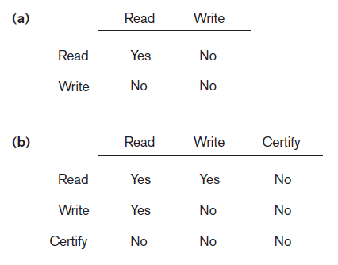
Multiversion Concurrency Control Techniques (3 of 3)
Multiversion two-phase locking using certify locks
Three locking modes: read, write, and certify
Figure 21.6 Lock compatibility tables (a) Lock compatibility table for read/write locking scheme (b) Lock compatibility table for read/write/certify locking scheme

Slide 27
21.4 Validation (Optimistic) Techniques and Snapshot Isolation Concurrency Control
Optimistic techniques
Also called validation or certification techniques
No checking is done while the transaction is executing
Updates not applied directly to the database until finished transaction is validated
All updates applied to local copies of data items
Validation phase checks whether any of transaction’s updates violate serializability
Transaction committed or aborted based on result

Slide 28
Concurrency Control Based on Snapshot Isolation
Transaction sees data items based on committed values of the items in the database snapshot
Does not see updates that occur after transaction starts
Read operations do not require read locks
Write operations require write locks
Temporary version store keeps track of older versions of updated items
Variation: serializable snapshot isolation (S S I)

Slide 29
21.5 Granularity of Data Items and Multiple Granularity Locking
Size of data items known as granularity
Fine (small)
Coarse (large)
Larger the data item size, lower the degree of concurrency permitted
Example: entire disk block locked
Smaller the data item size, more locks required
Higher overhead
Best item size depends on transaction type

Slide 30
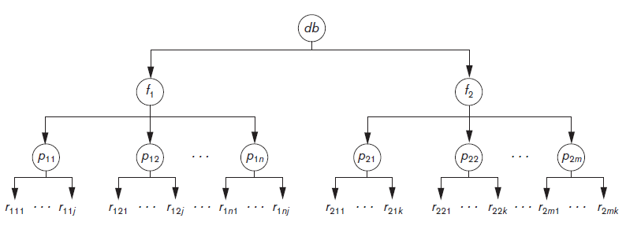
Multiple Granularity Level Locking (1 of 4)
Lock can be requested at any level
Figure 21.7 A granularity hierarchy for illustrating multiple granularity level locking

Slide 31
Multiple Granularity Level Locking (2 of 4)
Intention locks are needed
Transaction indicates along the path from the root to the desired node, what type of lock (shared or exclusive) it will require from one of the node’s descendants
Intention lock types
Intention-shared (I S)
Shared locks will be requested on a descendant node
Intention-exclusive (I X)
Exclusive locks will be requested

Slide 32
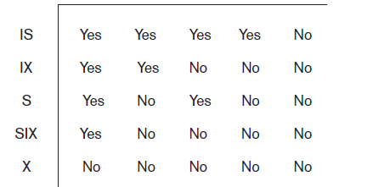
Multiple Granularity Level Locking (3 of 4)
Intention locks are needed
Shared-intension-exclusive (S I X)
Current node is locked in shared mode but one or more exclusive locks will be requested on a descendant node
Figure 21.8 Lock compatibility matrix for multiple granularity locking

Slide 33
Multiple Granularity Level Locking (4 of 4)
Multiple granularity locking (M G L) protocol rules
The lock compatibility (based on Figure 21.8) must be adhered to.
The root of the tree must be locked first, in any mode.
A node N can be locked by a transaction T in S or I S mode only if the parent node N is already locked by transaction T in either I S or I X mode.
A node N can be locked by a transaction T in X, I X, or S I X mode only if the parent of node N is already locked by transaction T in either I X or S I X mode.
A transaction T can lock a node only if it has not unlocked any node (to enforce the 2P L protocol).
A transaction T can unlock a node, N, only if none of the children of node N are currently locked by T.

Slide 34
21.6 Using Locks for Concurrency Control in Indexes (1 of 2)
Two-phase locking can be applied to B-tree and B+ -tree indexes
Nodes of an index correspond to disk pages
Holding locks on index pages could cause transaction blocking
Other approaches must be used
Conservative approach
Lock the root node in exclusive mode and then access the appropriate child node of the root

Slide 35
Using Locks for Concurrency Control in Indexes (2 of 2)
Optimistic approach
Request and hold shared locks on nodes leading to the leaf node, with exclusive lock on the leaf
B-link tree approach
Sibling nodes on the same level are linked at every level
Allows shared locks when requesting a page
Requires lock be released before accessing the child node

Slide 36
21.7 Other Concurrency Control Issues (1 of 2)
Insertion
When new data item is inserted, it cannot be accessed until after operation is completed
Deletion operation on the existing data item
Write lock must be obtained before deletion
Phantom problem
Can occur when a new record being inserted satisfies a condition that a set of records accessed by another transaction must satisfy
Record causing conflict not recognized by concurrency control protocol

Slide 37
Other Concurrency Control Issues (2 of 2)
Interactive transactions
User can input a value of a data item to a transaction T based on some value written to the screen by transaction T′, which may not have committed
Solution approach: postpone output of transactions to the screen until committed
Latches
Locks held for a short duration
Do not follow usual concurrency control protocol

Slide 38
21.8 Summary
Concurrency control techniques
Two-phase locking
Timestamp-based ordering
Multiversion protocols
Snapshot isolation
Data item granularity
Locking protocols for indexes
Phantom problem and interactive transaction issues

Slide 39

Copyright

